Slide 1






EUROPEAN YEAR OF SKILLS
Canary Islands

Slide 2
1. WORK-LINKED TRAINING PROJECTS

Slide 3

Aim
➔ Work-linked training projects to facilitate access to work through learning and work experience in an occupation for up to twelve months
Strategic Sectors
➔ Hospitality and Tourism
➔ Information and communication technologies
➔ Mechanical Manufacturing
➔ Green transition
➔ Personal care services
➔ Consumption chain: Manufacturers and distribution
➔ Renewable energies
Target groups
Unemployed
Priority for those with no professional qualifications or under-qualified
With greater insertion
problems
55% are women

Slide 4
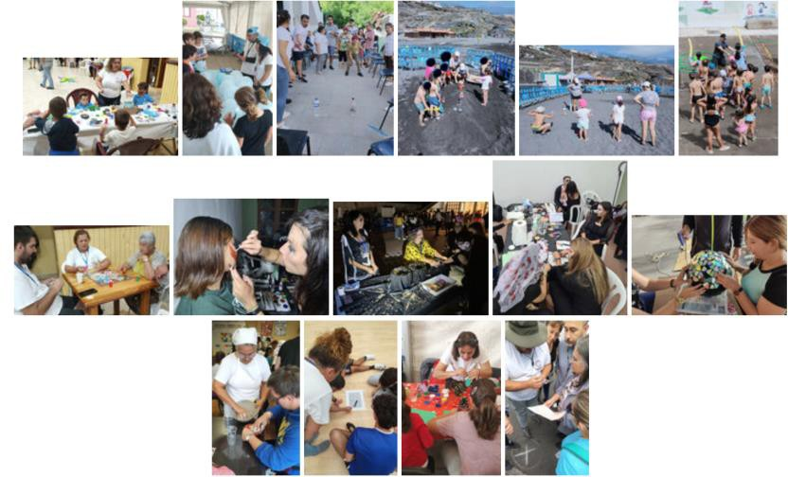
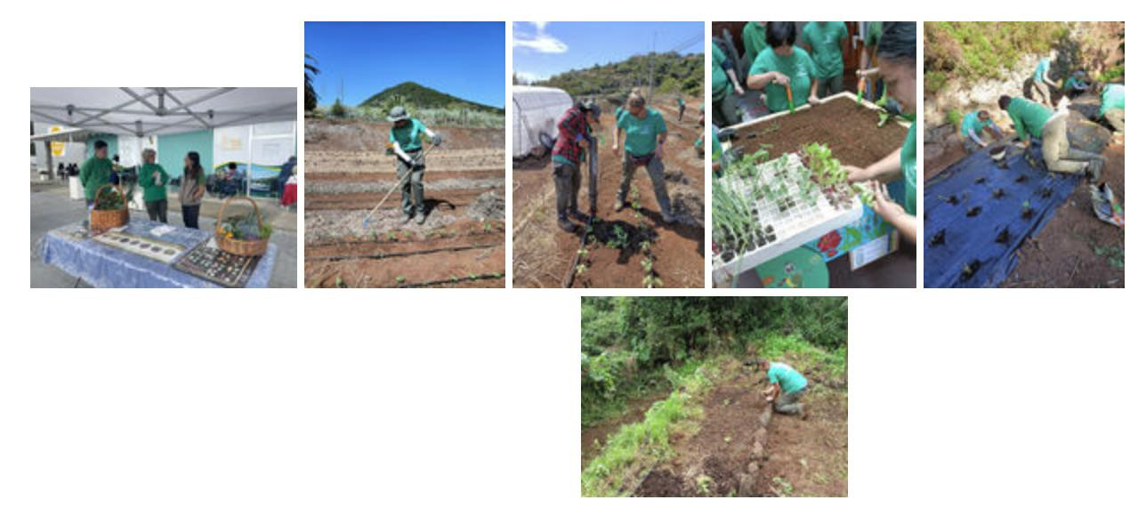
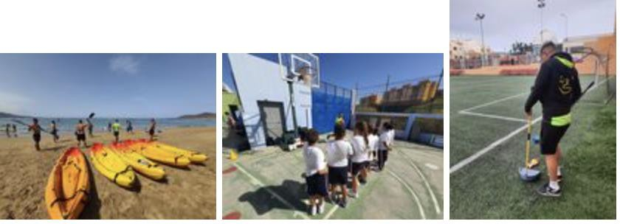
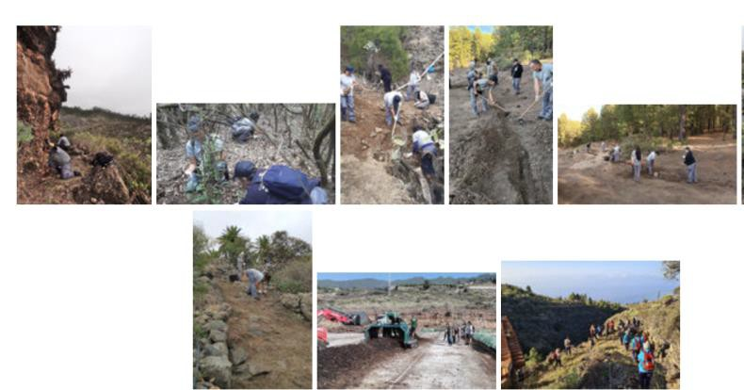
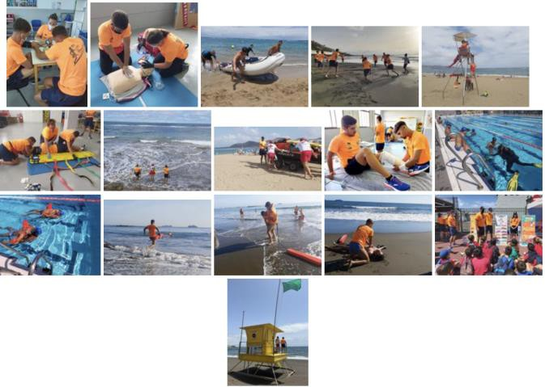
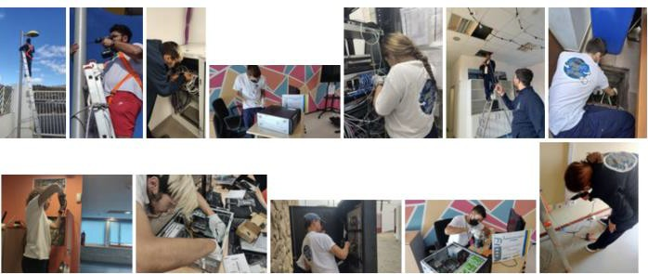
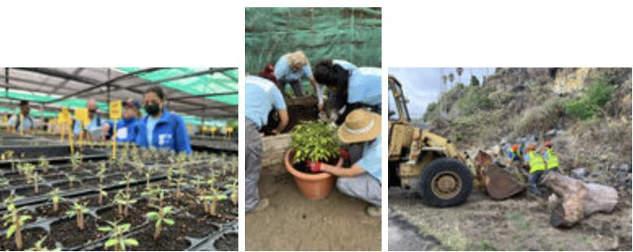
Gallery of images and videos of Special Employment and Training Projects begun in 2022 and implemented 2023 https://www3.gobiernodecanarias.org/empleo/formacionenalternanciaconelempleo/galeria/galeria.jsp?anio=2022&tipo=peef

Slide 5

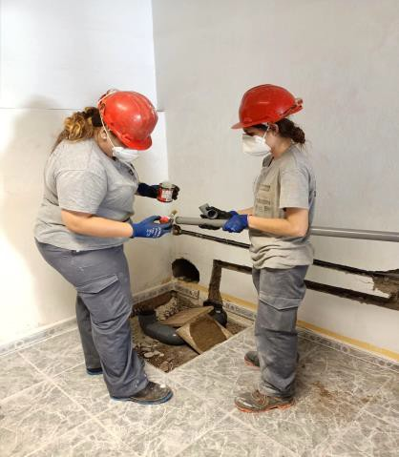
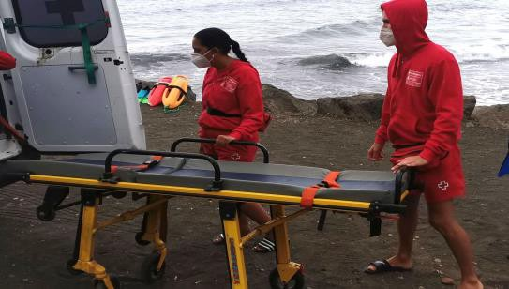
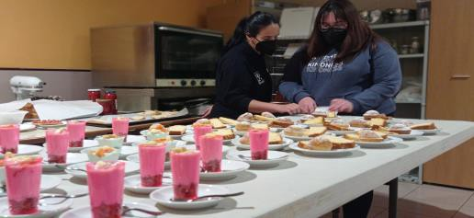
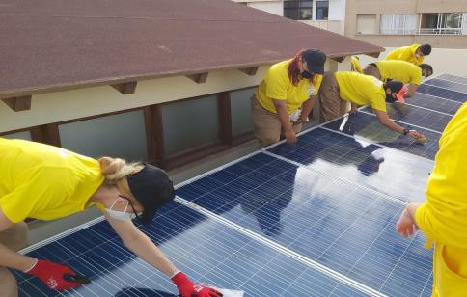
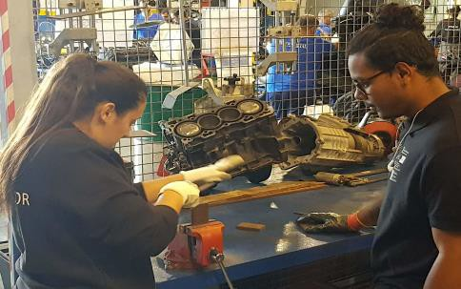
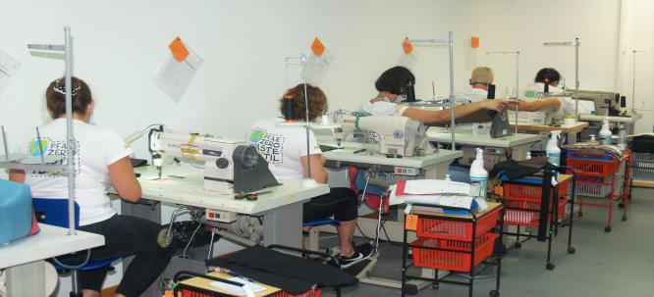
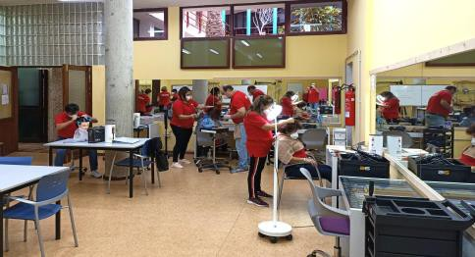
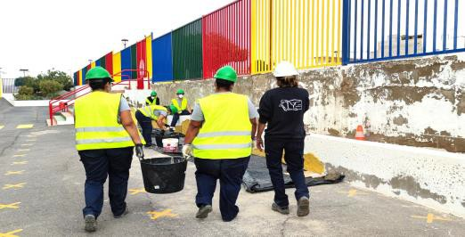
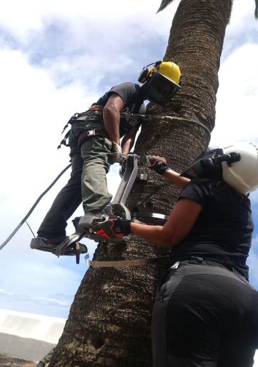
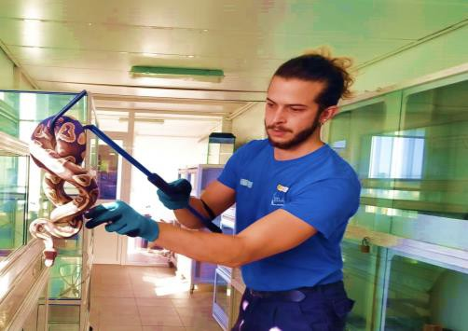
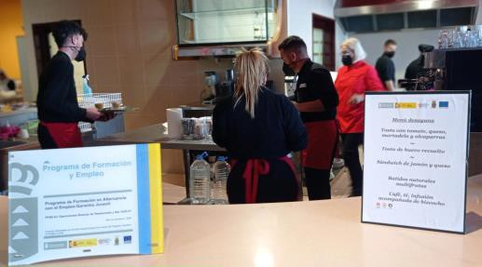
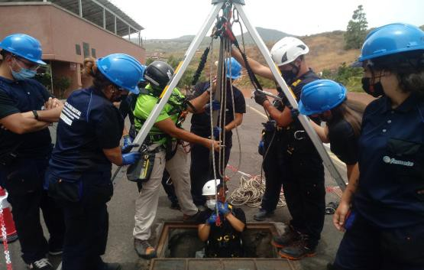
List of projects in operation in 2023
https://www3.gobiernodecanarias.org/empleo/formacionenalternanciaconelempleo/listados/listado.jsp?zona=canarias&tipo=todos&tipo riodo=funcionamiento&anio=2021&entidad=todas&tipo_listado=sencillo&orden=nombre

Slide 6
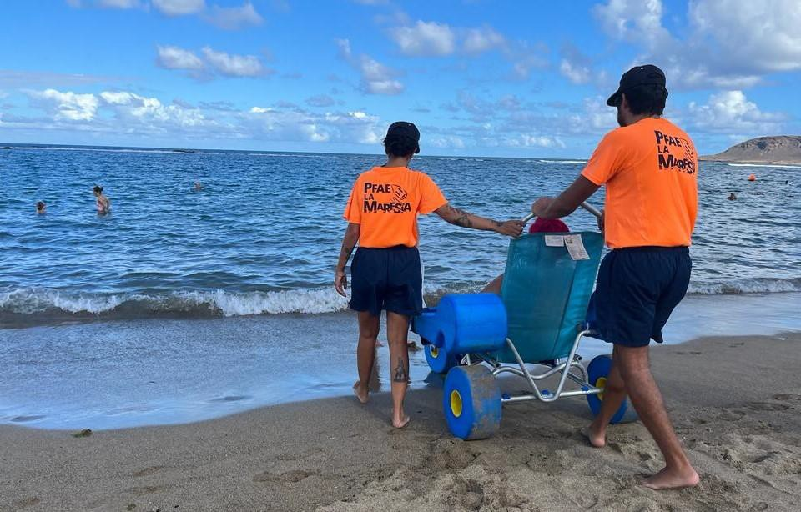

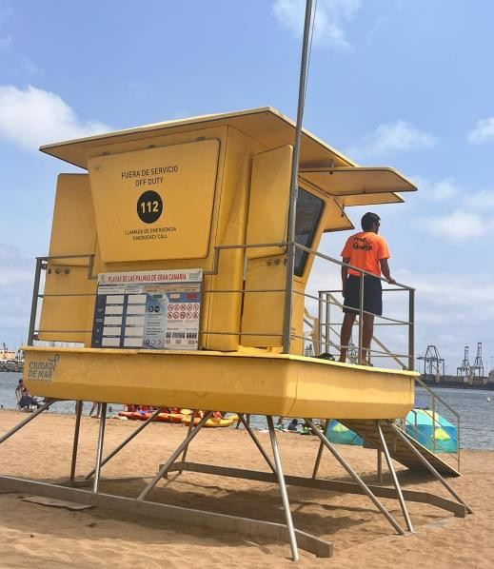
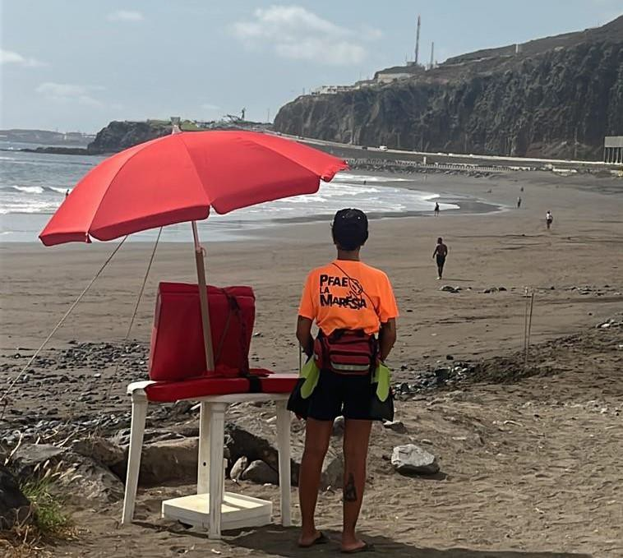
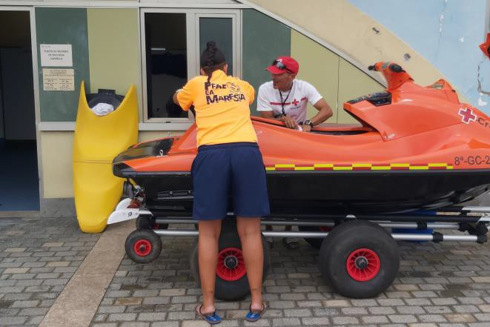
Lifeguarding in water sports facilities and in natural water spaces.
Skills
➔ Perform specific swimming techniques.
➔ Prevent accidents and emergencies.
➔ Rescue in case of accidents.
➔ Assist as first responder in case of an accident.

Slide 7
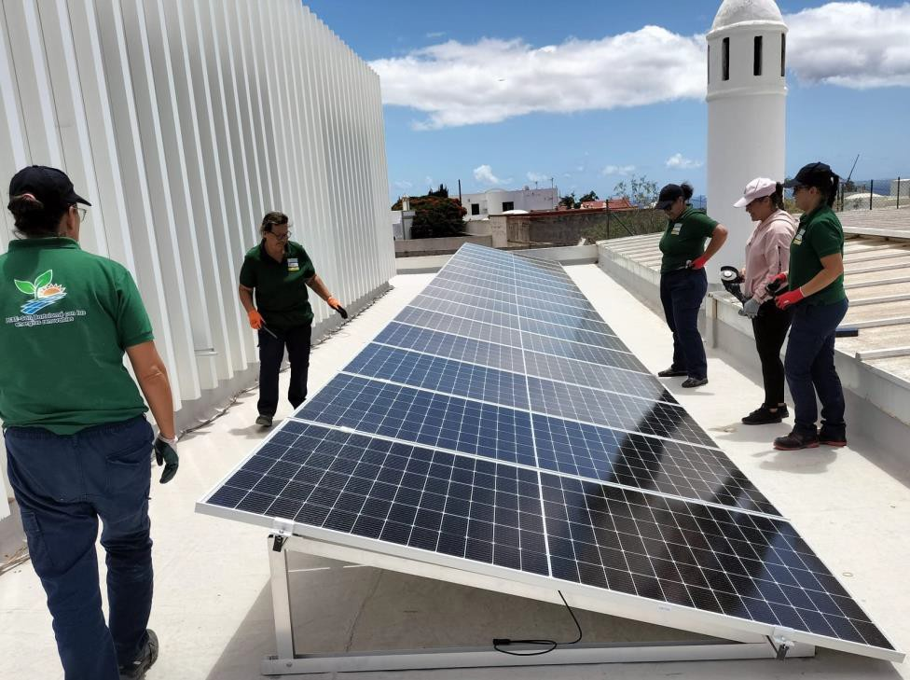
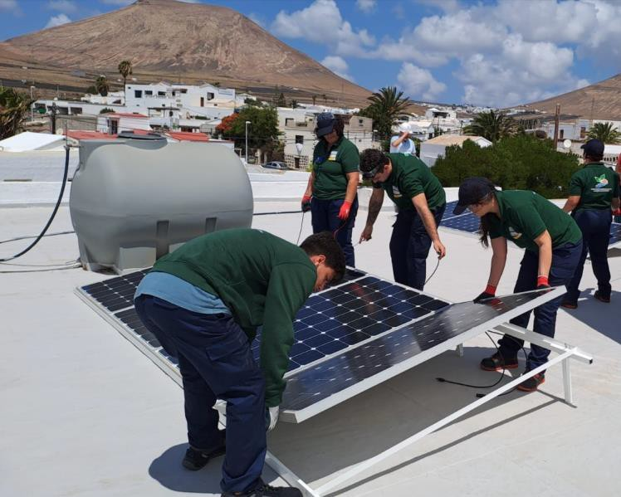
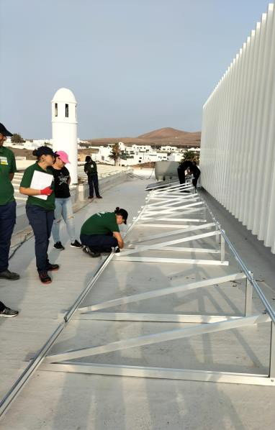
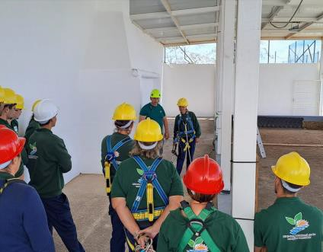
Installation and maintenance of Renewable Energy Installations.
Skills
➔ Basic machining operations
➔ Installation and maintenance of solar thermal installations
➔ Installation and maintenance of photovoltaic solar installations
➔ Installation and maintenance of low power wind installations.

Slide 8
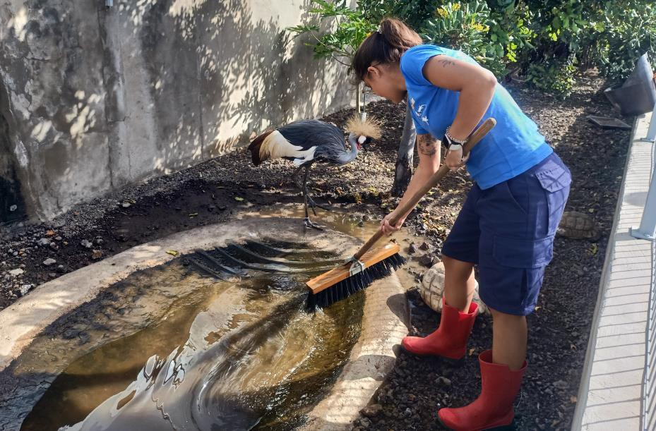
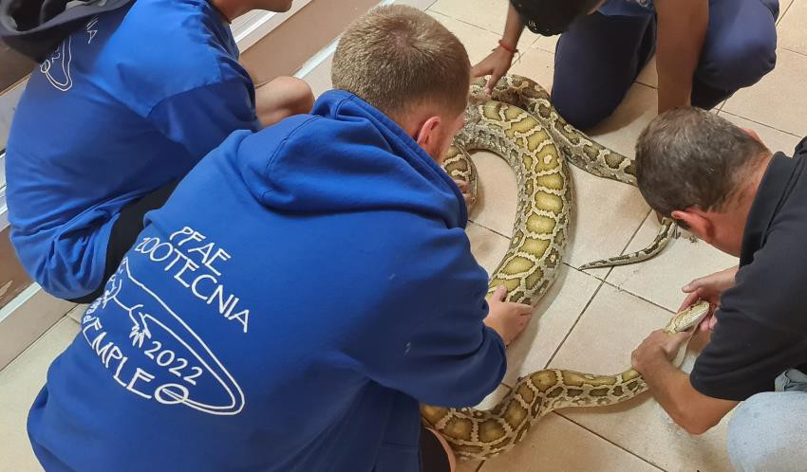
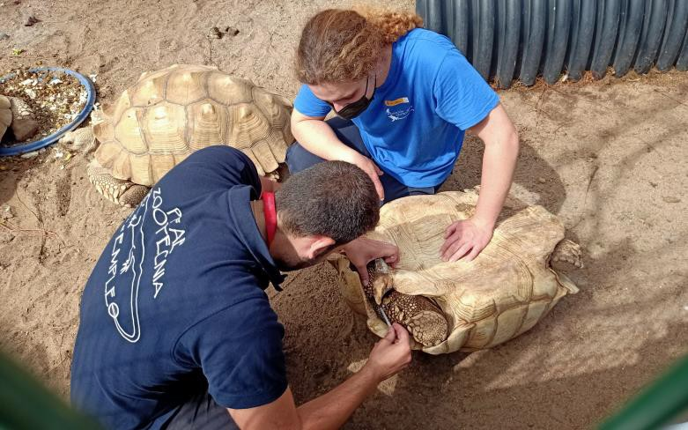
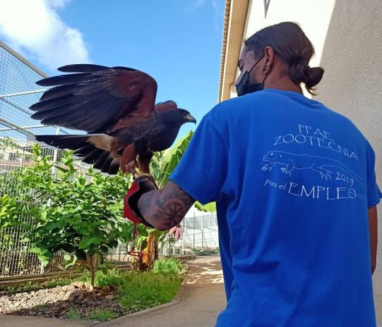
Care of wild animals in zoos and aquariums.
Skills
➔ Monitor wild animal facilities and enclosures in zoos and aquariums.
➔ Apply safety measures, cleaning and disinfection systems in animal enclosures.
➔ Assist the manager in clinical practice, examining, caring for and feeding animals.
➔ Carry out environmental training and improvement, immobilisation and handling of animals by physical means, following animal welfare criteria.

Slide 9
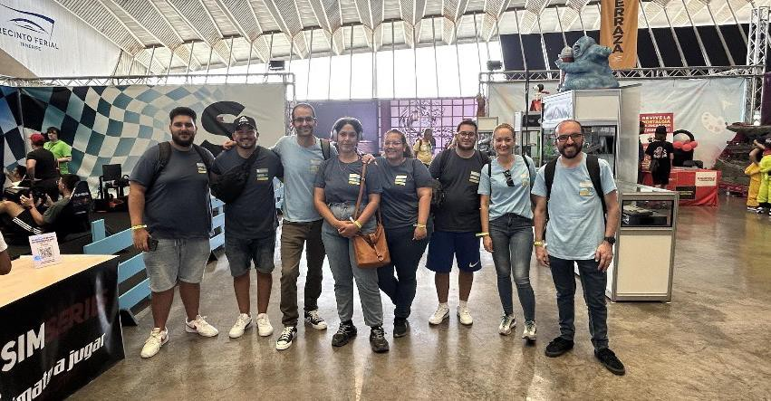

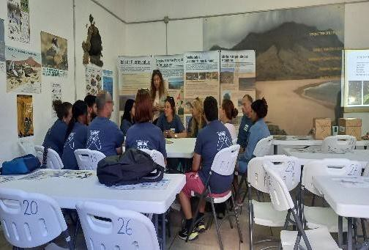
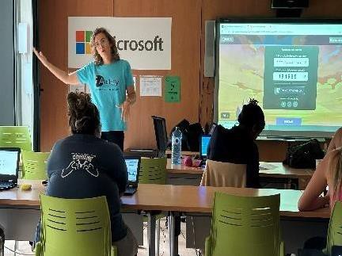
Preparing and Publishing Web Pages. Gaming & Esports.
Skills
➔ Design, create and publish web pages.
➔ Design, create and publish web pages.
➔ Technology – Video Games – Sports clubs.
➔ Entrepreneurship/management in Esports.
➔ Marketing & esports – Digital content & esports.
➔ Innovation workshop

Slide 10
2. PROJECTS WITH INTEGRATED LABOUR MARKET INSERTION ITINERARIES

Slide 11


Aim
➔ Training projects for the labour integration of people with special difficulties, immigrants, people facing social exclusion and people with disabilities.
Features of the Projects
➔ Reception and diagnostic phase
➔ Training for professional aptitude certificate
➔ Further training
➔ Personal development workshops
➔ Labour market guidance and insertion modules
➔ In-company internship
➔ Monitoring and evaluation
Target groups
Unemployed
Priority for those with no professional qualifications or under-qualified
Immigrants, socially excluded persons and people with disabilities

Slide 12
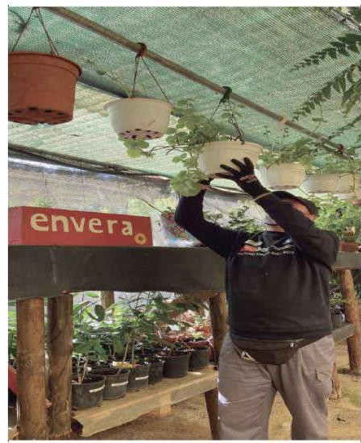
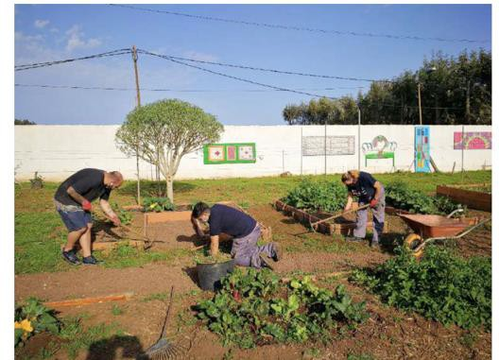
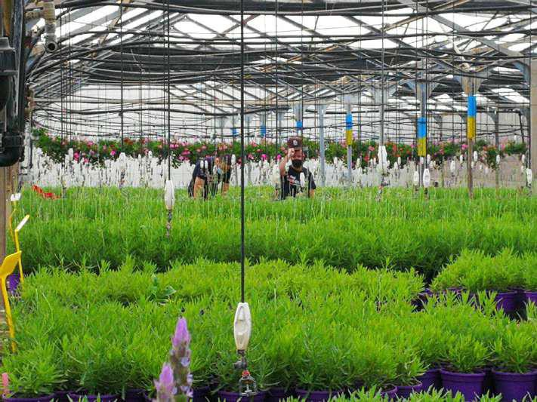
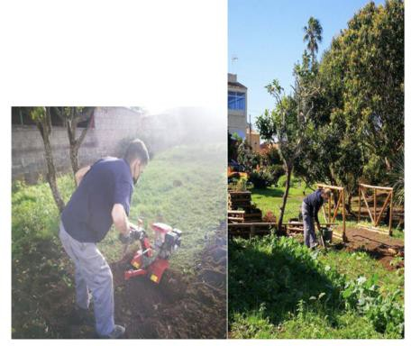
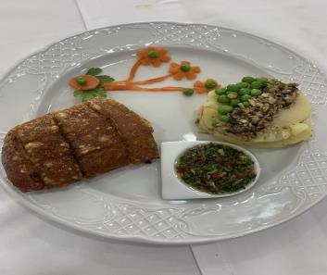
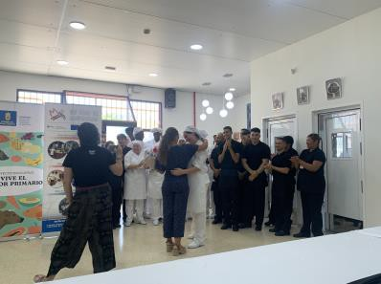
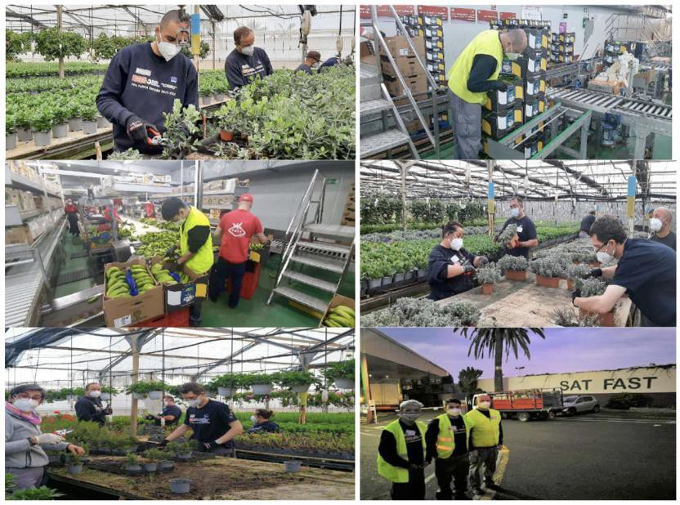
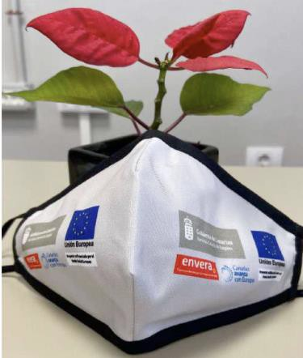
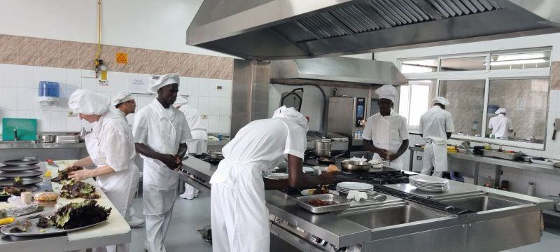
https://www.facebook.com/people/Servicio-Canario-de-Empleo/100057269597415/

Slide 13
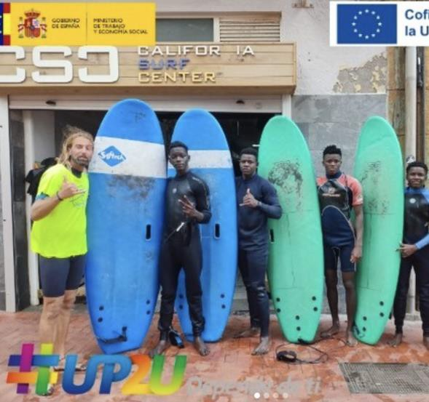
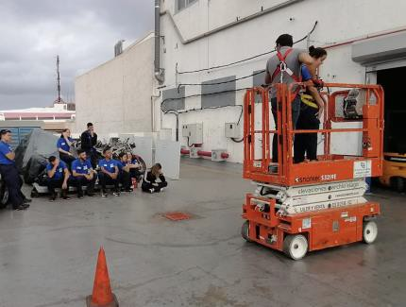
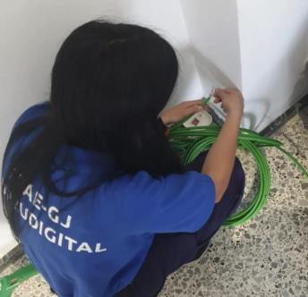
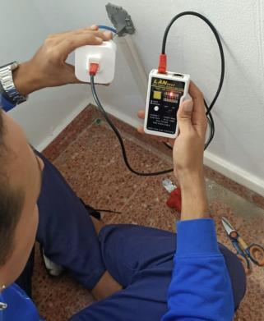
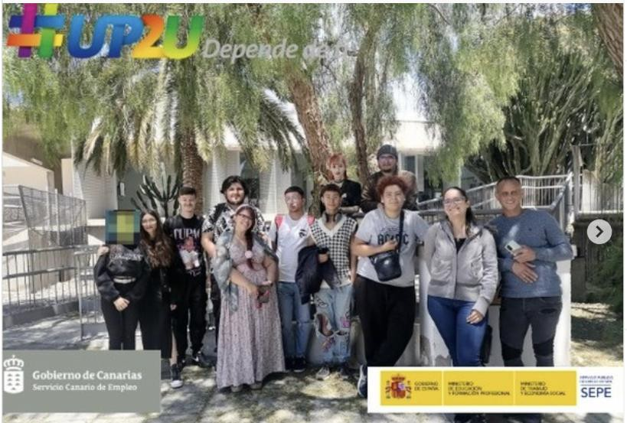
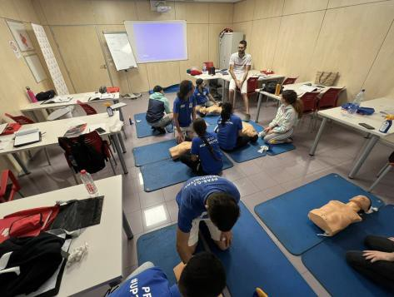
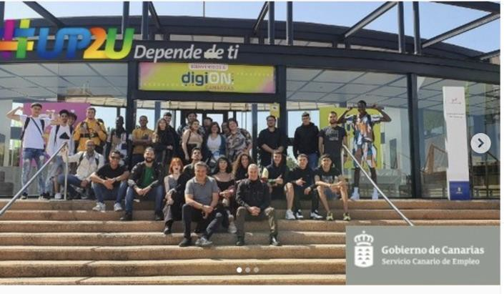
Youth Guarantee project for Young People Under Judicial Measures

Slide 14





Comprehensive Support Project for the Labour Insertion of Immigrants and Refugees

Slide 15
3. "REVALUING AGRICULTURE" PROJECTS

Slide 16
Aim
➔ To promote agricultural employment among immigrants in the Islands, covering a detected need for adequate labour
Specific objectives
➔ Identify and integrate into the project unemployed immigrants with a possibility of entering agriculture, mainly as employees.
➔ Improve the basic skills the participants need to carry out agricultural tasks by providing beginner-level training programmes in the field.
➔ Manufacturing. Detect the profiles as needed for the project, find immigrants that match the profiles, then put them in contact with businesses, through direct recruitment management.

Slide 17

Target groups
Training to be provided
120 people who have preferably been immigrants in the 36 months prior to joining the programme qualified as Unaccompanied Alien Minors (MENA)
➔ Fertilisers
➔ Pest control measures and products
➔ Irrigation techniques
➔ Occupational hazard prevention
➔ Spanish for foreigners

Slide 18






Slide 19
4. "ENERGY REFITTING AND EFFICIENCY” PROJECTS

Slide 20
Aim
➔ Work-linked training projects for energy efficiency refitting and works in public buildings.
Training to be provided
➔ ENAC008PO ENERGY EFFICIENCY IN BUILDING CONSTRUCTION
➔ EOCJ011PO INSTALLER OF EXTERIOR THERMAL INSULATION SYSTEMS (SATE):
APPLYING THERMAL INSULATING MORTARS
➔ SEAG061PO CONSTRUCTION AND DEMOLITION WASTE MANAGEMENT.
➔ BIM TECHNOLOGY
Target groups
Unemployed
55% are women

Slide 21





Felo Monzón-Gran Canaria Integrated Vocational Training Centre

Slide 22


THANK YOU
https://www.gobiernodecanarias.org/empleo/portal/web/sce

